Slide 1
1. Introduction
2. Understanding Solutions oriented AI
3. Tools & techniques
4. About next Part #2

Slide 2
HX (Human eXperience)
the entirety of an individual's interactions, emotions, perceptions, and thoughts throughout their life journey ….
What
education is a way to make one’s mental models more accurate by internalizing the knowledge and experience other people have collected throughout their lives
How
HX
Helps present to occur better
Assess future to be better

Slide 4


Slide 5


Slide 6
Area | Predictive AI Application | Examples and Benefits
Customer Behaviour Analysis | Predict customer preferences and behaviour. | - Personalized Recommendations: Predict products or plans a user might be interested in based on browsing history and past purchases. Churn Prediction: Identify customers at risk of cancelling subscriptions and offer retention incentives.
Pricing Strategies | Forecast optimal pricing for different markets and customer segments. | - Dynamic Pricing: Adjust subscription prices based on demand, market trends, and customer willingness to pay. Discount Optimization: Predict the impact of different discount levels on conversion rates and profitability.
Marketing Campaigns | Optimize marketing efforts based on customer data and predicted outcomes. | - Targeted Advertising: Predict which customers are likely to respond to specific promotions and tailor ads accordingly. Campaign Effectiveness: Forecast the success of marketing campaigns and adjust strategies in real-time.
Sales Forecasting | Predict future subscription sales and revenue. | - Demand Planning: Forecast demand for subscription plans to manage resources and inventory efficiently. Revenue Projections: Predict future revenue streams from new and existing subscriptions.
Customer Support | Enhance customer support by predicting common issues and providing proactive solutions. | - Issue Prediction: Predict the most common support issues and prepare solutions or FAQs. Support Ticket Routing: Automatically route tickets to the best-suited support agents based on predicted issue complexity and agent expertise.
User Segmentation | Identify and target different customer segments based on predicted behaviors and preferences. | - Segmentation for Personalization: Segment users for personalized content, offers, and communication. Lifecycle Marketing: Predict where customers are in their lifecycle and target them with appropriate messages.
Customer Lifetime Value | Predict the long-term value of customers to inform acquisition and retention strategies. | - Value Prediction: Forecast the lifetime value of customers based on their usage patterns and engagement. Acquisition ROI: Assess the return on investment for acquiring different customer segments.
Fraud Detection | Identify and mitigate fraudulent activities related to subscriptions and payments. | - Fraud Patterns: Predict patterns of fraudulent behavior based on transaction data. Real-time Alerts: Generate alerts for suspicious activities and transactions.
Localization | Adapt services and offerings based on predicted preferences and trends in different countries and regions. | - Cultural Preferences: Predict cultural preferences and tailor subscription offerings accordingly. Local Demand: Forecast demand for different plans and features in various geographical markets.
Content Recommendation | Suggest relevant content or features to users based on their predicted interests. | - Content Personalization: Recommend articles, videos, or tutorials related to the user’s subscription. Engagement Increase: Increase user engagement by predicting and serving content that aligns with their interests.
Inventory Management | Predict inventory needs for any physical components or materials related to subscription services. | - Stock Management: Forecast the need for physical materials (e.g., starter kits) based on subscription sales predictions. Supply Chain Optimization: Manage supply chains more efficiently by predicting inventory turnover.
Renewal and Upgrade Offers | Predict the likelihood of renewal and the potential for upselling or cross-selling subscription upgrades. | - Renewal Likelihood: Forecast which customers are likely to renew their subscriptions. Upgrade Potential: Identify customers likely to upgrade their plans and target them with appropriate offers.
User Experience Enhancement | Predict user needs and optimize the website experience accordingly. | - Navigation Optimization: Predict which sections of the website users are likely to visit and optimize navigation paths. UX Personalization: Tailor the website layout and content based on predicted user behavior.
Logistics and Fulfillment | Predict logistical needs for delivering physical components associated with subscriptions. | - Delivery Forecasting: Predict delivery demand to optimize shipping schedules. Cost Management: Forecast and manage delivery costs based on predicted shipment volumes.
Subscription Plan Optimization | Predict which features or plan attributes are most valued by customers to refine subscription offerings. | - Feature Popularity: Forecast the popularity of different plan features to guide development. Plan Customization: Predict customer preferences to create tailored subscription plans.

Slide 7
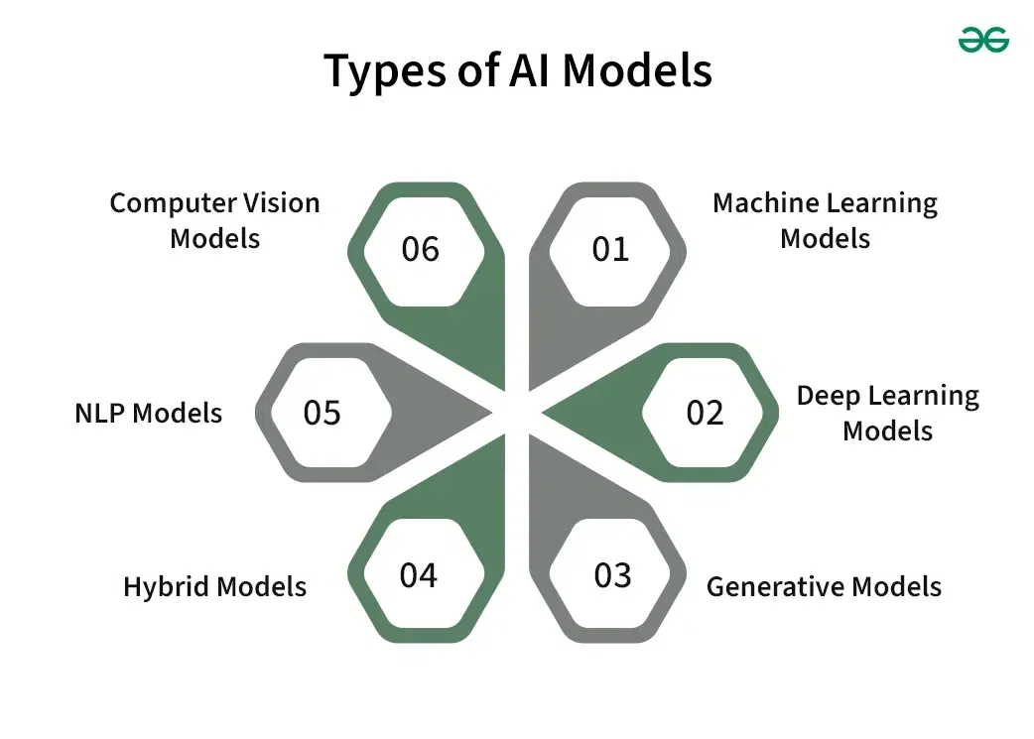

Slide 8
1. Machine Learning AI Models
Machine learning models are created to learn from data and improve performance on certain tasks. These models include a variety of techniques, such as support vector machines, random forests, decision trees, and linear regression. They are widely used in applications such as reinforcement learning, regression, clustering, and classification.
Common Algorithms:
Linear and Logistic Regression: Basic yet powerful methods for prediction and classification.
Decision Trees and Random Forests: Useful for handling complex datasets with high accuracy.
Support Vector Machines (SVM): Excellent for classification tasks, especially in high-dimensional spaces.
When to Use:
Ideal for predictive analytics in business, healthcare, finance, and more.
When working with labeled datasets to perform classification or regression tasks.
Using historical financial data to predict market trends and investment opportunities.
Identifying patterns that indicate when a customer might leave a service.
Real-Life Application:
Real Estate Pricing: Real estate companies use linear regression to predict home prices based on characteristics like size, location, and number of rooms, helping both buyers and sellers make informed decisions
2. Deep Learning AI Models
Deep learning models are advanced forms of machine learning that use neural networks with many layers. These models are particularly good at processing large volumes of unstructured data. They are extensively used in applications involving image recognition, natural language processing, and audio recognition.
Common Algorithms:
Convolutional Neural Networks (CNNs): Dominant in processing images, video, and other 2D data.
Recurrent Neural Networks (RNNs): Effective for sequential data such as time series or natural language.
Long Short-Term Memory Networks (LSTMs): A special kind of RNN, capable of learning long sequences of information.
When to Use:
Ideal for tasks involving big data and complex pattern recognition like voice recognition systems, image classification, and time series forecasting.
When handling unstructured data such as texts, images, and sounds.
Using LSTMs to understand and generate human speech for applications like Siri and Google Assistant.
Employing CNNs to identify individuals in security systems and smartphones.
Real-Life Application:
Medical Diagnosis: Hospitals use CNNs to analyze medical images such as X-rays and MRIs to diagnose diseases and suggest treatments, improving accuracy and speed in medical diagnostics.
3. Generative AI Models
Generative models are designed to generate new data instances that resemble your training data, enabling machines to learn the distribution of data points and generate similar items. They’re crucial in fields requiring new content generation or feature enhancement.
Common Algorithms:
Generative Adversarial Networks (GANs): Use a dual-network architecture of generators and discriminators to improve each other.
Variational Autoencoders (VAEs): Provide a probabilistic way to describe an observation in latent space.
When to Use:
When you need to enhance, increase, or generate new data samples from existing data.
Suitable for tasks like data augmentation, synthetic data generation for training models, and creative content generation.
Using GANs to create realistic and infinite new environments for video game development.
Utilizing VAEs to generate new clothing items based on current fashion trends.
Real-Life Application:
Film and Video: Film companies use GANs to enhance the resolution of old movies or generate realistic special effects for new productions without the need for expensive practical effects.

Slide 9
4. Hybrid AI Models
Hybrid models combine multiple different AI techniques to leverage their strengths and mitigate weaknesses. These models are especially useful in complex scenarios where a single model type is insufficient.
Common Algorithms:
Integrated Neural Networks: Combining CNNs and RNNs to handle tasks that involve both visual and sequential data processing.
Ensemble Methods: Using a combination of various models like decision trees and regression models to improve predictions.
When to Use:
In complex decision-making environments where diverse data types must be processed simultaneously.
When the problem requires robustness and accuracy beyond what can be achieved by a single model.
Integrating computer vision for navigation with NLP for voice commands and control.
Combining multiple classifiers to detect patterns of fraudulent transactions with higher accuracy.
Real-Life Application:
Smart Home Systems: Hybrid models in IoT devices can process environmental data to automate home systems efficiently, like adjusting lighting based on time of day and occupancy detected through cameras and sensors.
5. NLP AI Models
Natural Language Processing (NLP) models are specialized to process and understand human language, making them essential for applications involving text data.
Common Algorithms:
BERT (Bidirectional Encoder Representations from Transformers): Improves the understanding of the context within the text.
GPT (Generative Pre-trained Transformer): Excels in generating coherent and contextually appropriate text.
When to Use:
When dealing with tasks that involve human language, such as translating languages, generating text, or extracting information.
For applications like chatbots, sentiment analysis, and automated content generation.
Using GPT to write articles, compose poetry, or generate code.
Employing BERT to analyze customer reviews and determine the sentiment expressed in social media posts.
Real-Life Application:
Customer Support Automation: Companies use NLP models to power chatbots on their websites, providing instant responses to customer inquiries, which improves customer experience and operational efficiency.
6. Computer Vision AI Models
Computer vision models are tasked with interpreting and understanding visual information from the world, converting it into a digital format.
Common Algorithms:
CNNs: Standard for image classification and recognition tasks.
Capsule Networks: Designed to understand spatial hierarchies between features, potentially overcoming some of CNNs’ limitations.
When to Use:
When tasks require the interpretation of visual data, such as identifying objects, classifying images, or analyzing video content.
In applications like surveillance, quality control in manufacturing, and interactive gaming.
Using CNNs to detect defects in manufacturing products on assembly lines.
Employing capsule networks to improve the interaction of AI characters with environments in complex video games.
Real-Life Application:
Retail: Stores use computer vision to analyze customer behavior, optimize store layouts, and even to check out customers without the need for traditional cashiers, enhancing the shopping experience and reducing wait times.

Slide 10
Dream eleven
Data Acquisition
Data Ingestion
Kafka / AWS Glue
Data Processing
Databrick/Spark/Kinesis
Feature Engineering
ETL
Airflow/Prefect
Data Transformation
Pandas/Spark
Design . Development..
Model Training
tensorflow
Model Evaluation
Model Deployment
Monitoring & Logging
CI/CD
Data Lake
AWS S3/HDFS/Cloud
Data Sources
SQL/No-SQL/HDFS/S3/APIs/Kafka
Predict
Generate
Diagnose
Get data from Analytics team
Identify the feature & labels
Implement

